Slide 1
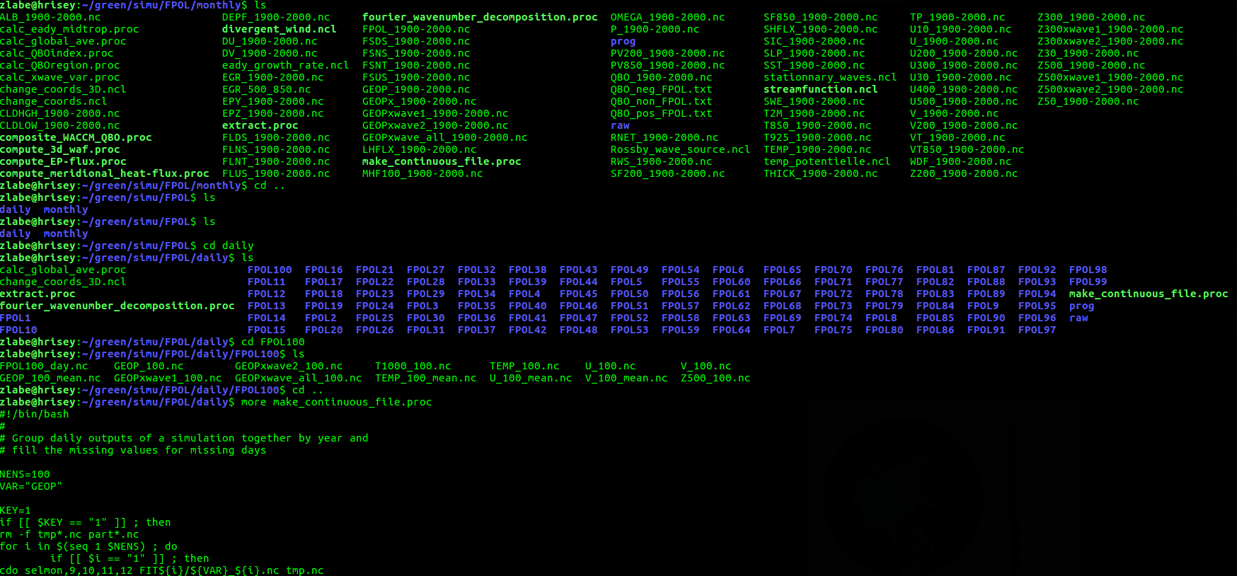

RESEARCH
WORKFLOW
https://github.com/zmlabe/ClimatePython

Slide 2
BAKER, 2016; NATURE NEWS

Slide 3
“
Today’s weather or climate scientist is far more likely to be debugging code written in Python… than to be poring over satellite images or releasing radiosondes.
”
D. Irving| Bulletin of the American Meteorological Society| 2016

Slide 4
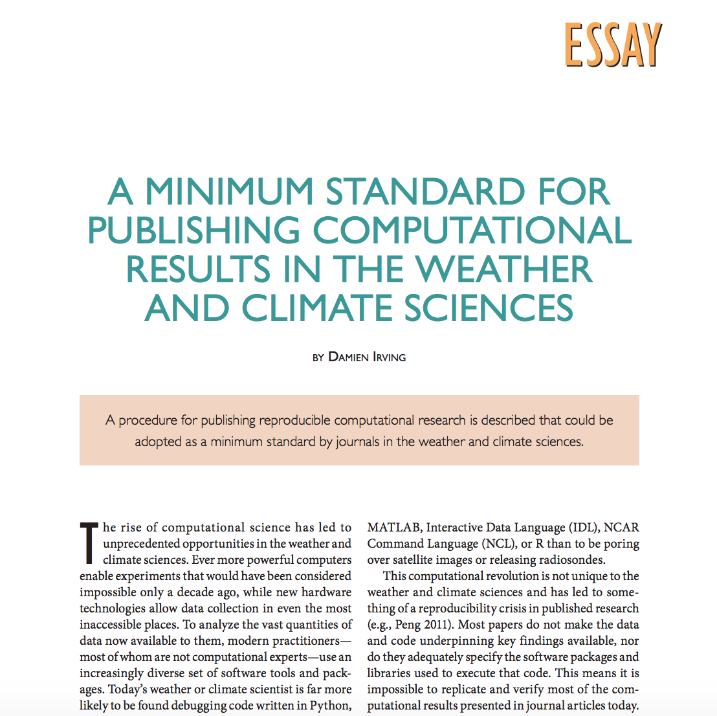
D. Irving| Bulletin of the American Meteorological Society| 2016

Slide 5

GROWING DATA

Slide 7
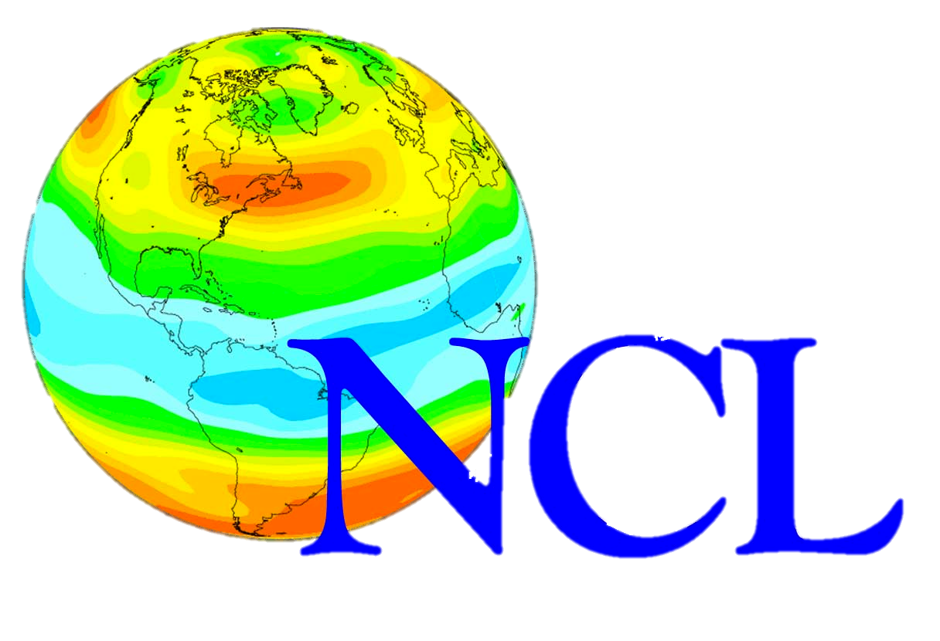
GROWING TOOLS

Slide 9
“
It helps to reduce the shame many scientists have about the quality of their code (i.e., they see that their peers are no ”better” at coding than they are)…
”
D. Irving| Bulletin of the American Meteorological Society| 2016

Slide 10
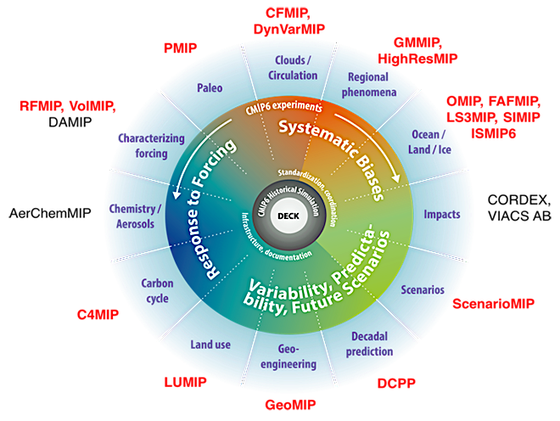
CMIP6
ADAPTED FROM EYRING ET AL. 2016

Slide 11
WE HAVE ALL DONE IT…
Data is available from the corresponding author upon request

Slide 12
WE HAVE ALL DONE IT…
Code is available from the corresponding author upon request

Slide 13
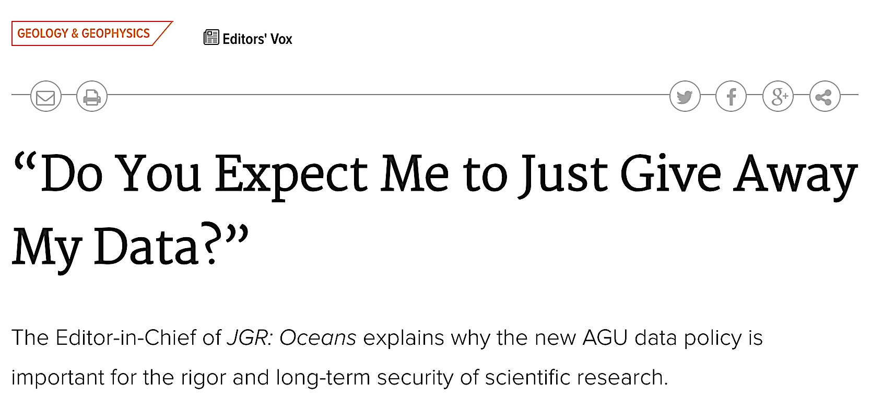
Increasing number of code and data policies

Slide 15
This is a good thing

Slide 16
So what can we do?

Slide 17
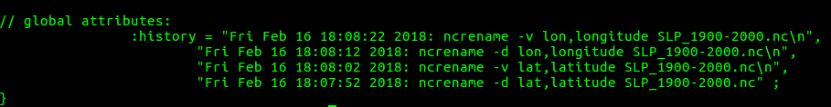
Pre-process data using NCO, CDO, or NCL
Download observational or reanalysis data
Advanced analysis of data using Python, NCL, etc
Create science figures
Download or conduct climate model simulation
Store processed data on remote server
WORKFLOW

Slide 18
Create a working directory and a backup directory for project
Download observational or reanalysis data
Advanced analysis of data using Python, NCL, etc
Create science figures
Download or conduct climate model simulation
Use of GitHub for version control with 1 repository per project
WORKFLOW

Slide 19
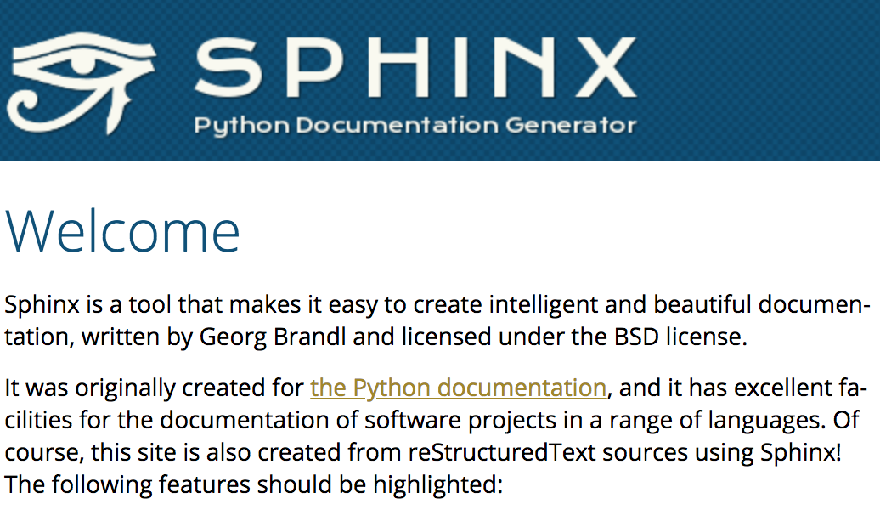
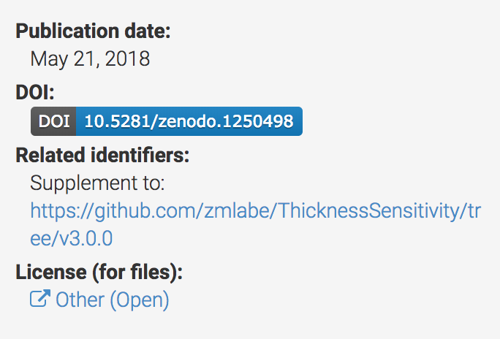
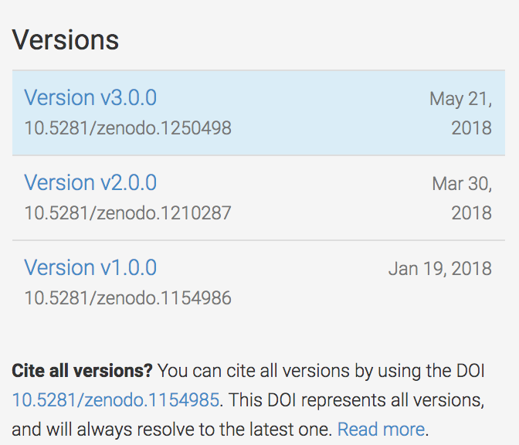
Assess code documentation
Download observational or reanalysis data
Advanced analysis of data using Python, NCL, etc
Create science figures
Download or conduct climate model simulation
Use Zenodo to create project DOI
WORKFLOW

Slide 20
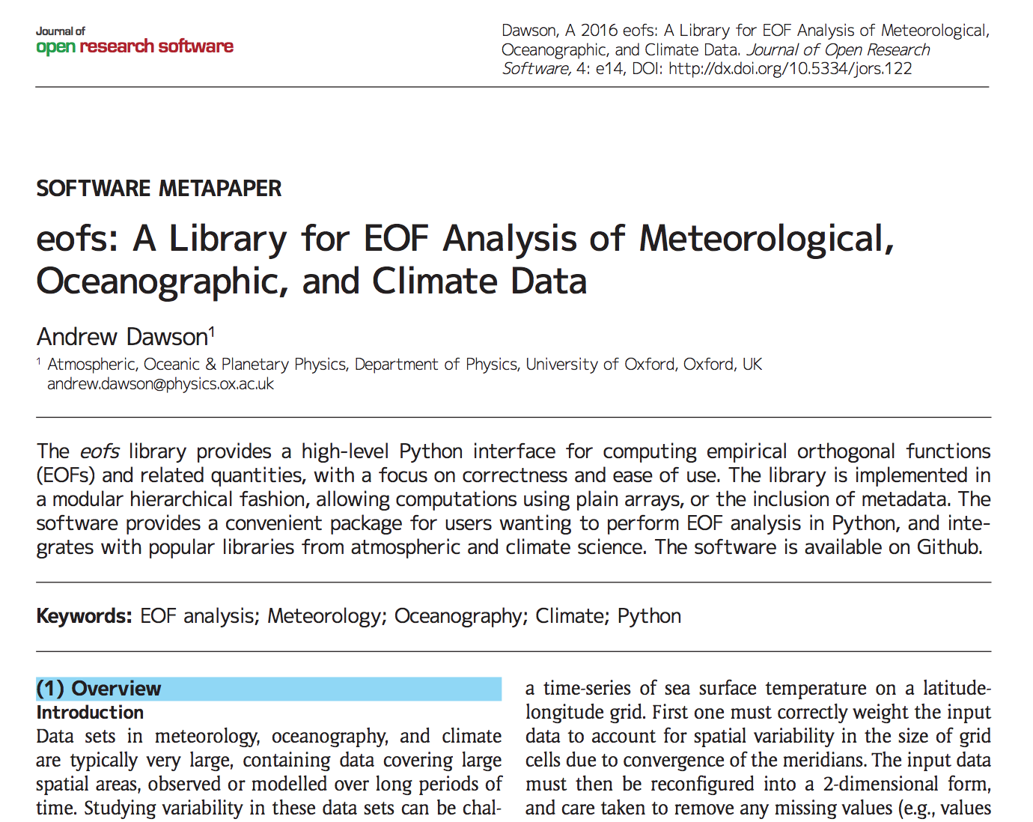
Behind each library

Slide 22
WHY
Transparency
Reproducibility
Code-sharing
Innovation
Open-science
Climate science needs this!
Is there a crisis in science?
Python is a growing community
Big data is the future
Science deserves to be shared

